Slide 1
Natural Disaster Help Application
Briana Crockett
David Kay
Deep Patel

Slide 2
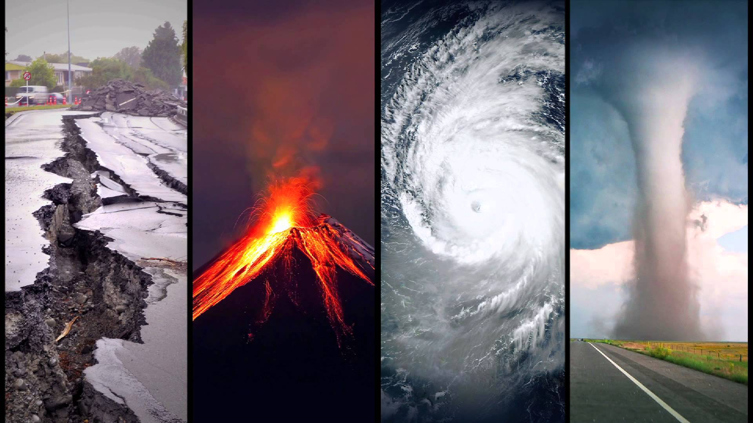
Our Idea
Create a mobile application that will give assistance to users caught in natural disasters such as tornadoes, hurricanes, and earthquakes.
Something beyond a “basic weather tracking app” by providing users with additional emergency services.
Give the average user and emergency services the important information such as locations of appropriate shelters, how to protect themselves during the storm, and emergency response dispatch.

Slide 3
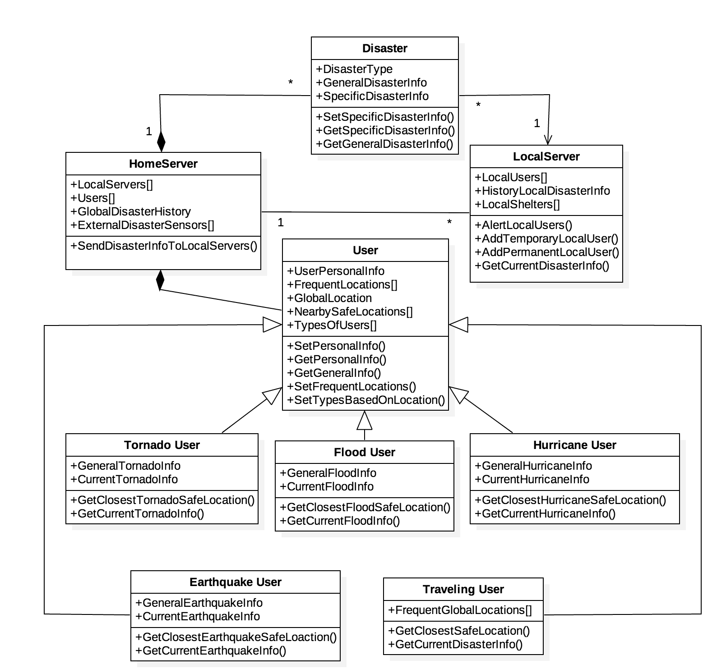
Software Architecture
Client-Server Architecture Model
Implement some form of Repository Architecture Model

Slide 4

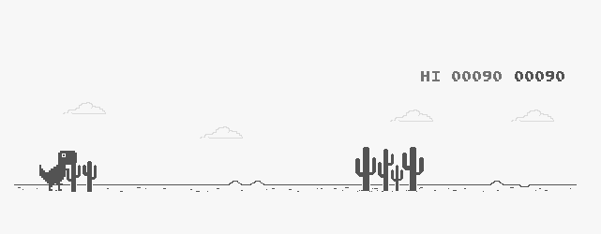
Project Issues
Some issues outside of our control:
User loss of cellular service.
User device running out of power.
Effects
Current Environment.
Glitches in the App or API affect usability
Installed Systems
Incorrect implementation of the application can adversely affect user device.

Slide 5
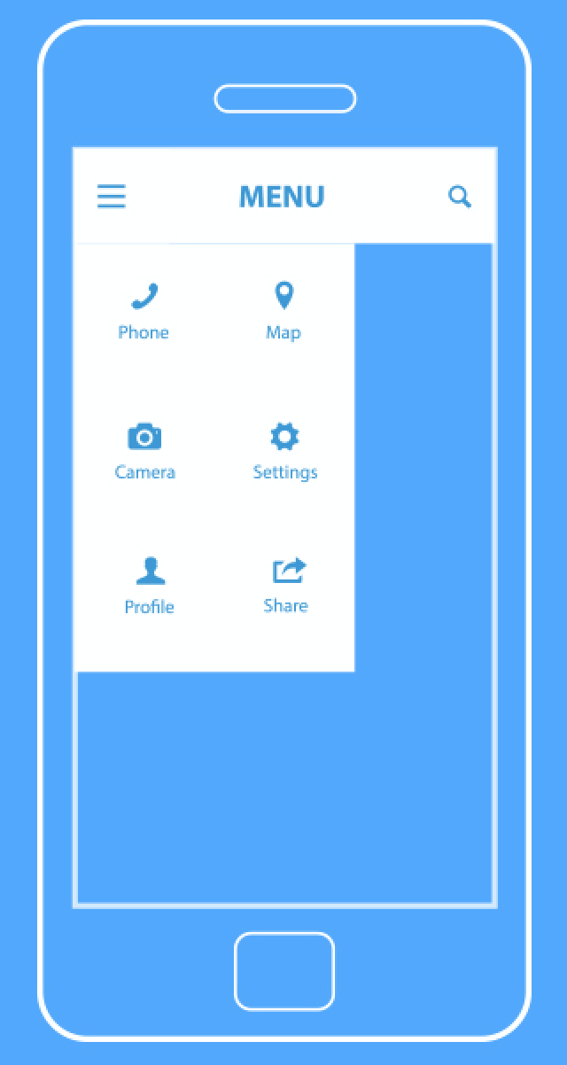
Planning, Migration, and Risks
Planning Phases:
Planning, Development, Testing, Pre-Release, Release
Migration
Requirements:
Emergency response must be trained in ER systems.
Servers must be prepared for user data.
Application compatibility.
Data:
User data must be converted into a format compatible with the data servers.
Risks
Any issues with the third party APIs could affect production and usability until fixed.

Slide 6

Design Goals
Accurate weather information, prioritizing speedy navigation data.
The navigation should be displayed when needed.
It should be easy for users to select/change destination.

Slide 7
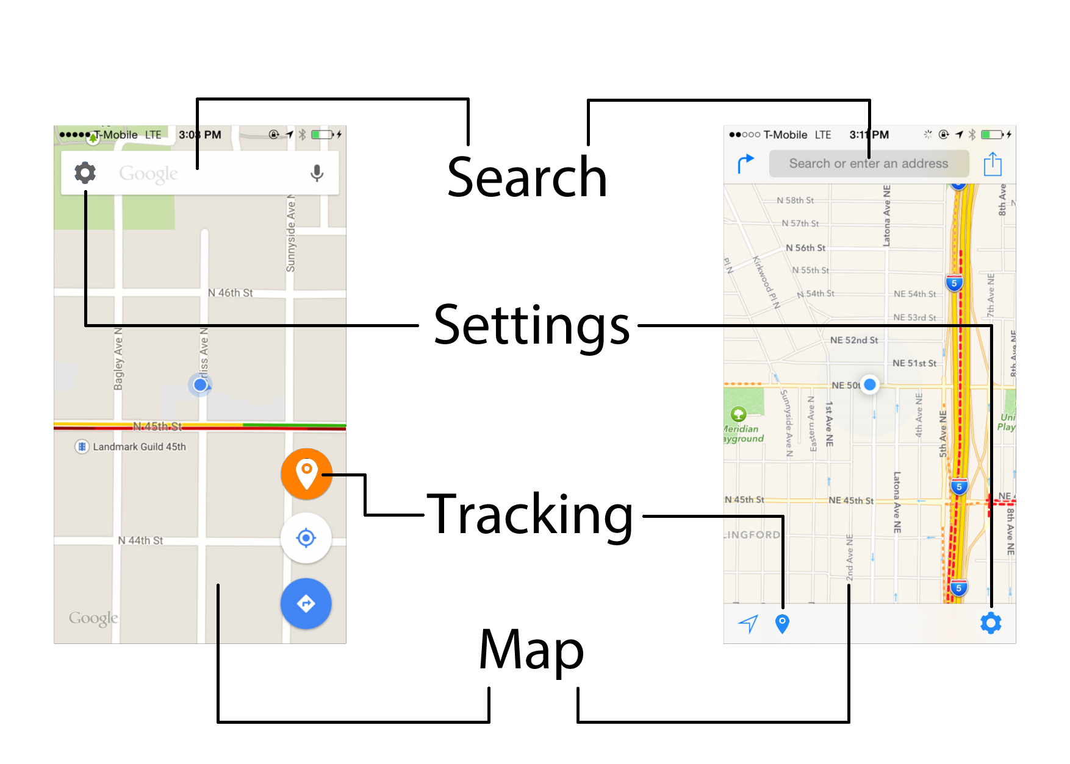
User Interface
Navigation Display
Settings Display

